Slide 1


AutoFlash: Study Flashcard Generation Using KG and AI
23/05/2025
By Mariana Gouveia, 53356, David Guilherme, 56333,
Guilherme Prazeres, 64373, Duarte Gonçalves, 64465

Slide 2

Motivation
Students face overwhelming study material.
Traditional flashcards demand manual effort.
Goal: Use AI and semantic understanding via KG to automate this process and support more efficient and accessible learning.

Slide 3
System Workflow
User Input
Entity Expansion (LLM)
Entity ID Retrieval (Wikidata API)
SPARQL Query Triple Extraction (Wikidata)
Natural Language Flashcard Generation (LLM)
Flashcard Delivery and UI Options

Slide 4


User Input
Topic Selection
Input quality
The user begins by entering a general academic topic through a web-based interface.
No input validation mechanisms are implemented, as development efforts are focused on output quality.
e.g. "Deep Learning"

Slide 5

Entity Expansion (LLM)
Related Topics
A Large Language Model (LLM), accessed via the OpenRouter API, expands the initial topic into a list of up to 10 related subtopics. Returns a JSON-formatted list of strings
e.g. "Deep Learning“, Neural Networks“ "Backpropagation“, ” Gradient Descent”

Slide 6
Entity Identification (Wikidata)
ID
Entity Linking
For each subtopic, the system queries the Wikidata Search API to retrieve the corresponding Q-ID. It then constructs a dictionary mapping each entity name to its respective Q-ID.
e.g. "Deep Learning“, → Q33002955

Slide 7

SPARQL Triplet Extraction
KG Querying
Get Q-ID
Using the Q-IDs, the system formulates SPARQL queries to extract relevant structured data from the Wikidata KG.
Retrieves up to 10 subject–predicate–object triples per entity, ensuring that no subject–predicate pair appears more than once with different objects, to avoid redundancy.
e.g. (Deep Learning, subclassof, Machine Learning), (Backpropagation, used in, Neural Networks).

Slide 8



Natural Language Flashcard Generation
Each retrieved triple is sent to an LLM, which converts it into a fluent and educationally meaningful natural language sentence. The output is stored in a structured JSON format:
Summary
From facts and questions
Facts
From Triples
Questions
Question: Subject + Predicate
Answer: Object
e.g. "summary": “This is a concise summary”
e.g. "facts": [ "Fact 1", "Fact 2“, “Fact3”]
e.g. "questions": [ {"question": “This is a question?", "options": [“A", “B", “C", “D"], "correct_answer": “B"},

Slide 9






System Architecture
Extract related themes?
User input
Send user theme
LLM
Uses RESTful via OpenRouter API
Themes JSON List
ID
Query the Q-IDs
Processing
Q-IDs JSON List
Wikidata
Uses RESTful via Wikidata Search API
SPARQL to get triples
Processing
Triples JSON List
Flashcards
JSON Information
Triples to Human language?
Frontend
(Streamlit)
Backend
(Python)
JSON Information

Slide 10


Flashcard Formatting and Output Delivery
The web interface renders the JSON content into a series of flashcards. These include:
Summary
Facts Carrousel
A single paragraph providing an enriched and concise overview of the main topic.
Individual cards highlighting key factual information derived from the triples.
Export
Multiple-Choice
Summary and fact flashcards can be exported as images, allowing for offline study or integration into other educational resources.
Questions formed by subject and predicate, and response by the object. designed to test the user's understanding.

Slide 11
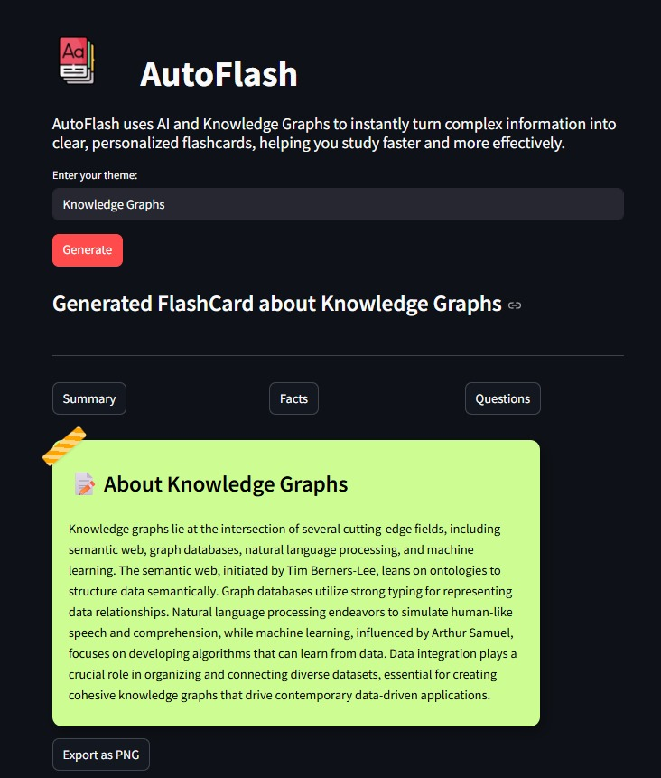
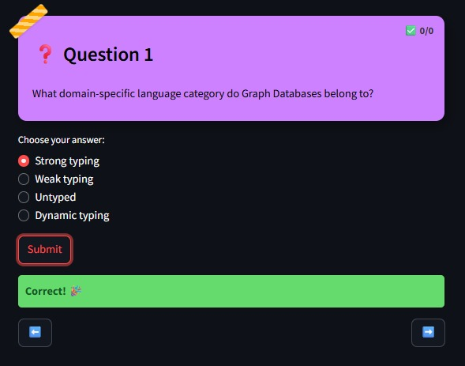
App Demo
Evaluation function

Slide 12
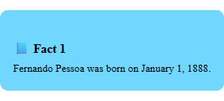

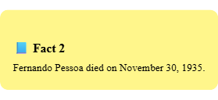
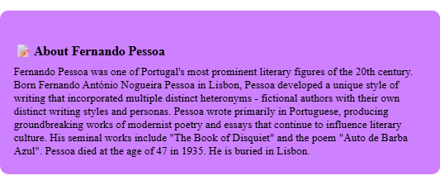
Flashcard Export to Image
Export Image
To support offline access and content sharing, the Flashcards HTML is captured and converted to PNG using a browser-side rendering library.

Slide 13
Evaluation Results
Internal evaluation due to time and cost constraints. (No large-scale user study)
⇓
1–5 Likert scale. ⇒ x3 rounds: 1 Summary, 2 Facts, 2 Multiple-Choice Questions.
⇓
Clarity: Understandability, structure, grammar.
Relevance: Alignment with source content.
Originality: Rephrasing vs. copying.
Best performance: Technical topics (Knowledge Graphs, DNA).
Lower performance: General topic (Portugal).
Inconsistent knowledge extraction and shallow content on open-ended prompts.
Showed the potential of integrating knowledge graphs and AI for education.

Slide 14
Future Work
Interface Improvements
Add filtering options
Support interactive formats (e.g., spaced repetition, MCQs)
Better Topic Expansion
Use domain-specific ontologies or taxonomies
Combine LLM with curated knowledge bases
Improved Evaluation
Involve unbiased participants
Use structured rubrics for assessment

Slide 15
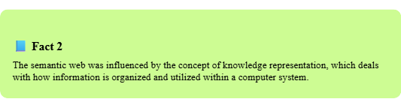
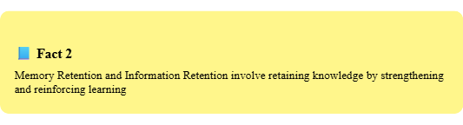
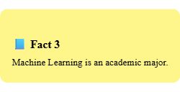
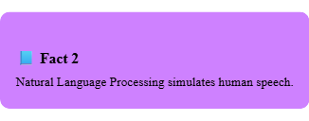
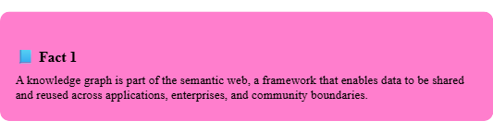
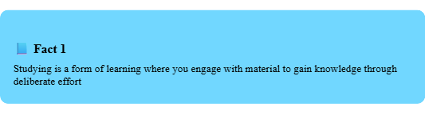
Thanks
Do you have any question?

